Slide 1

Confidence Interval
ML LABS PVT LTD || WWW.ANALYTICS6.COM || DATA SCIENCE , AI , ML ,COMPUTER VISION || TRAINING AND CONSULTING
Phone Number : 91-6362546088 || Email : contact@analytics6.com

Slide 2
Confidence Interval
A confidence interval for a proportion is a range of values that is likely to contain a population proportion with a certain level of confidence.
A confidence interval displays the probability that a parameter will fall between a pair of values around the mean.
ML LABS PVT LTD || WWW.ANALYTICS6.COM || DATA SCIENCE , AI , ML ,COMPUTER VISION || TRAINING AND CONSULTING
Phone Number : 91-6362546088 || Email : contact@analytics6.com

Slide 3
Confidence Interval
Confidence intervals measure the degree of uncertainty or certainty in a sampling method.
They are most often constructed using confidence levels of 95% or 99%.
ML LABS PVT LTD || WWW.ANALYTICS6.COM || DATA SCIENCE , AI , ML ,COMPUTER VISION || TRAINING AND CONSULTING
Phone Number : 91-6362546088 || Email : contact@analytics6.com

Slide 4
Why statistics use confidence intervals?
Statisticians use confidence intervals to measure uncertainty. A higher probability associated with the confidence interval means that there is a greater degree of certainty that the parameter falls within the bounds of the interval.
ML LABS PVT LTD || WWW.ANALYTICS6.COM || DATA SCIENCE , AI , ML ,COMPUTER VISION || TRAINING AND CONSULTING
Phone Number : 91-6362546088 || Email : contact@analytics6.com

Slide 5
Some important terms
Point estimate
Standard error
Confidence level
ML LABS PVT LTD || WWW.ANALYTICS6.COM || DATA SCIENCE , AI , ML ,COMPUTER VISION || TRAINING AND CONSULTING
Phone Number : 91-6362546088 || Email : contact@analytics6.com

Slide 6
Point estimate
A single valued estimate.
A single element chosen from a sampling distribution.
Conveys little information about the actual value of the population parameter, about the accuracy of the estimate.
ML LABS PVT LTD || WWW.ANALYTICS6.COM || DATA SCIENCE , AI , ML ,COMPUTER VISION || TRAINING AND CONSULTING
Phone Number : 91-6362546088 || Email : contact@analytics6.com

Slide 7
Point estimate
Point estimate is only as good as the sample it represents.
Random samples from the population – point estimate.
ML LABS PVT LTD || WWW.ANALYTICS6.COM || DATA SCIENCE , AI , ML ,COMPUTER VISION || TRAINING AND CONSULTING
Phone Number : 91-6362546088 || Email : contact@analytics6.com

Slide 8
Standard error
The standard error of a mean provides a statement of probability about the difference between the mean of the population and the mean of the sample.
ML LABS PVT LTD || WWW.ANALYTICS6.COM || DATA SCIENCE , AI , ML ,COMPUTER VISION || TRAINING AND CONSULTING
Phone Number : 91-6362546088 || Email : contact@analytics6.com

Slide 9
Confidence level
A confidence level refers to the percentage of all possible samples that can be expected to include the true population parameter.
For example, suppose all possible samples were selected from the same population, and a confidence interval were computed for each sample. A 95% confidence level implies that 95% of the confidence intervals would include the true population parameter.
ML LABS PVT LTD || WWW.ANALYTICS6.COM || DATA SCIENCE , AI , ML ,COMPUTER VISION || TRAINING AND CONSULTING
Phone Number : 91-6362546088 || Email : contact@analytics6.com

Slide 10
Confidence limits
Confidence limits are the maximum or minimum values above or below which you are confident (at a selected confidence level) that the statistic will occur.
ML LABS PVT LTD || WWW.ANALYTICS6.COM || DATA SCIENCE , AI , ML ,COMPUTER VISION || TRAINING AND CONSULTING
Phone Number : 91-6362546088 || Email : contact@analytics6.com

Slide 11
A point estimate is a single number
A confidence interval contains a certain set of possible values of the parameter.
Lower confidence limit Point estimate upper confidence limit
ML LABS PVT LTD || WWW.ANALYTICS6.COM || DATA SCIENCE , AI , ML ,COMPUTER VISION || TRAINING AND CONSULTING
Phone Number : 91-6362546088 || Email : contact@analytics6.com

Slide 12
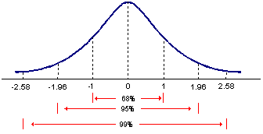
How to set Normal distribution curve?
ML LABS PVT LTD || WWW.ANALYTICS6.COM || DATA SCIENCE , AI , ML ,COMPUTER VISION || TRAINING AND CONSULTING
Phone Number : 91-6362546088 || Email : contact@analytics6.com

Slide 13
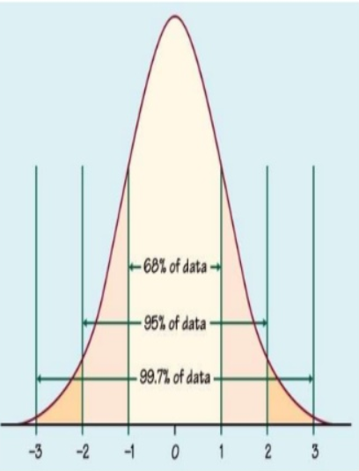
All normal curves N(µ,σ)
ML LABS PVT LTD || WWW.ANALYTICS6.COM || DATA SCIENCE , AI , ML ,COMPUTER VISION || TRAINING AND CONSULTING
Phone Number : 91-6362546088 || Email : contact@analytics6.com

Slide 14
All normal curves N(µ,σ)
68% of all observations are within 1 sd (σ) of mean (µ).
c = 68% , z ≈ 1
95% of all observations are within 2 sd (σ) of mean (µ).
c = 95% , z ≈ 2
99.7% of all observations are within 3 sd (σ) of mean (µ).
c = 95% , z ≈ 2
ML LABS PVT LTD || WWW.ANALYTICS6.COM || DATA SCIENCE , AI , ML ,COMPUTER VISION || TRAINING AND CONSULTING
Phone Number : 91-6362546088 || Email : contact@analytics6.com

Slide 15
Confidence interval
Confidence % | Standard deviations (z)
50% | 0.67449
75% | 1.15035
90% | 1.64485
95% | 1.95996
97% | 2.17009
99% | 2.57583
99.9% | 3.29053
ML LABS PVT LTD || WWW.ANALYTICS6.COM || DATA SCIENCE , AI , ML ,COMPUTER VISION || TRAINING AND CONSULTING
Phone Number : 91-6362546088 || Email : contact@analytics6.com

Slide 16
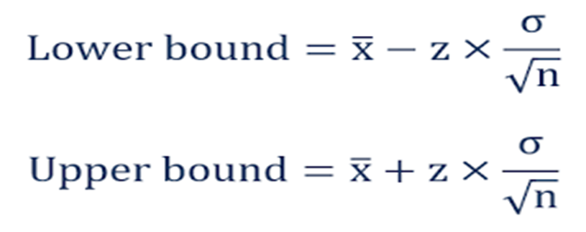
Confidence interval
If you don’t know your population mean (μ) but you do know the standard deviation (σ), you can find a confidence interval for the population mean, with the formula:
ML LABS PVT LTD || WWW.ANALYTICS6.COM || DATA SCIENCE , AI , ML ,COMPUTER VISION || TRAINING AND CONSULTING
Phone Number : 91-6362546088 || Email : contact@analytics6.com

Slide 17

Confidence interval formula
where x = the sample mean
σ= the population standard deviation
z= the z value for the desired confidence level alpha(obtained from an area under the normal curve table)
ML LABS PVT LTD || WWW.ANALYTICS6.COM || DATA SCIENCE , AI , ML ,COMPUTER VISION || TRAINING AND CONSULTING
Phone Number : 91-6362546088 || Email : contact@analytics6.com

